Slide 1
Patient Health Monitoring System
Hritu Kiran Sharma

Slide 2
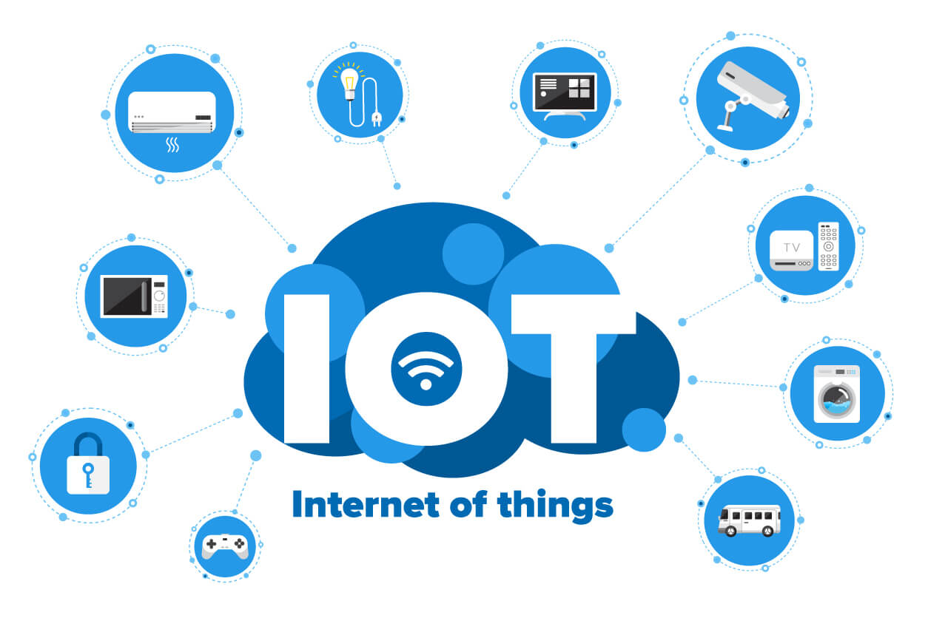
(Monton A.L., 2021)

Slide 3
Introduction to IoT
Integration of device, sensors, software and network to perform certain tasks.
Makes task easier and improve efficiency.

Slide 4
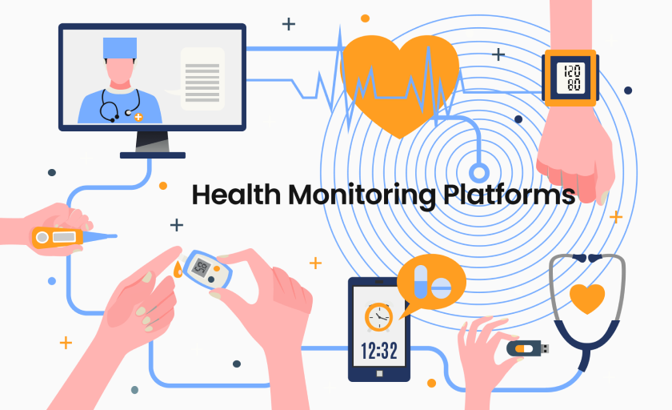
(Besedina E., N.A.)

Slide 5
Patient Health Monitoring System
IoT device that measures the body vitals using different sensors.
Data can be accessed remotely.
Doctors can monitor the health of their patient remotely.

Slide 6
Historical Perspective
Early methods of measuring vital signs were introduced by Santorio, Galileo and Floyer.
Sphygmomanometer and ECG monitoring was also introduced in the early period.

Slide 7
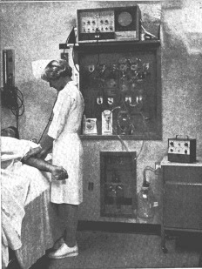
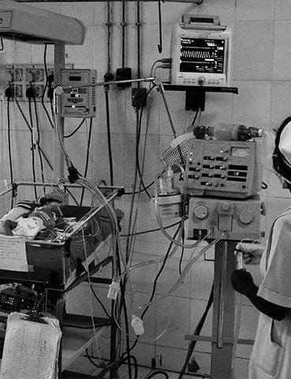
Historical Perspective
(Associates C., 2023)
(e2aglen, 2017)

Slide 8
Key Features of Health Monitoring System
Measures body temperature, blood pressures, heart rate and blood oxygen.
Collected data is sent to the web server or cloud.

Slide 9
Key Features of Health Monitoring System
Provides real-time monitoring from anywhere.
Reduces the number of time to visit the clinic.

Slide 10

(Clinical F., 2018)

Slide 11
Benefits of Patient Health Monitoring System
Helps to identify any chronic disease in its early stage.
Helps to monitor patient over any distance.
Helps to monitor patient remotely during the times like COVID 19.

Slide 12

(Dr Josh, 2022)

Slide 13
Challenges
Risk of data loss and theft.
Initial cost of the system.
Potential communication challenges.
Technical issues may arise.

Slide 14

Future of Patient Health Monitoring System
Use Artificial Intelligence and Machine Learning to analyze the data and get more accurate results.
(HealthSnap, 2023)

Slide 15
Future of Patient Health Monitoring System
Improved interfaces for the users.
Added more sensors to measure other body vitals.
Improved security to protect patient’s data.

Slide 16
Conclusion
It is improving remote healthcare.
It is saving people’s time and cost and making management of chronic disease efficient.
It has improved a lot over the years and will continue to advance with the technology.

Slide 17
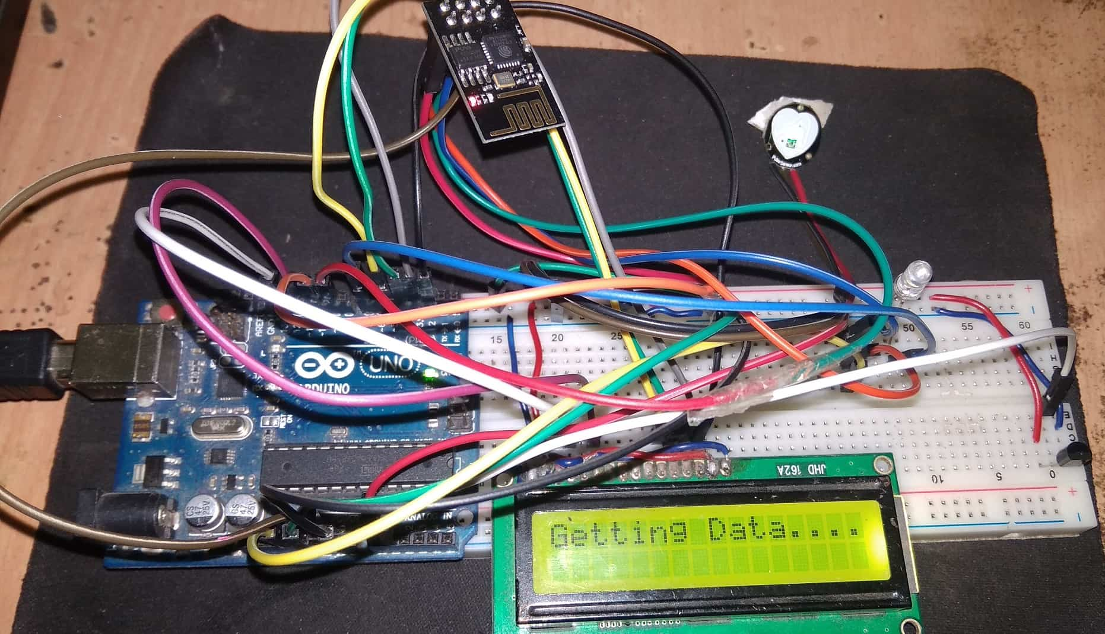
Some Patient Health Monitoring System Projects
(Admin, 2024)

Slide 18
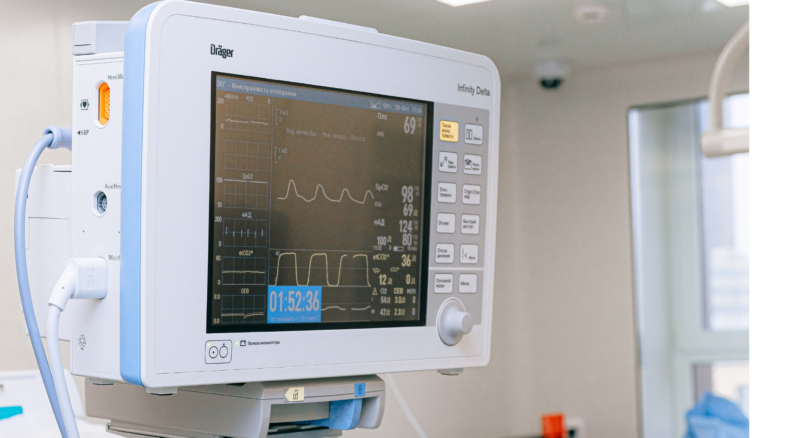
Some Patient Health Monitoring System Projects
(Watson R., 2021)

Slide 19
References
https://www.globalsign.com/en-sg/blog/what-internet-things-and-how-does-it-work Aryne Leign Monton 2021 November 23, What is the Internet of Things and how does it Work? GlobalSign
https://integrio.net/blog/patient-health-monitoring-platforms Elena Besedina, How to Develop Remote Patient Health Monitoring Platforms Integrio Systems
https://conferenceny.com/2023/10/11/open-enrollment-2023/ Conference Associates, Open Enrollment 2023, Conference Associates
https://www.glenmedsolutions.com/2017/09/21/history-patient-monitoring-systems/ e2aglen 2017 September 21, The History of Patient Monitoring Systems Glen Med Solutions
http://www.femtosimclinical.com/History%20of%20Physiologic%20Monitors.htm Femtosim Clinical Inc. 2018 June 6, Fifty Years of Physiologic Monitors
https://smartclinix.net/challenges-in-remote-patient-monitoring-and-the-best-solutions/ Dr Josh 2022 January 13, Remote Patient Monitoring Challenges & Solutions SmartClinix
https://healthsnap.io/ai-in-remote-patient-monitoring-the-top-4-use-cases-in-2023/ HealthSnap 2023 September 6th, AI in Remote Patient Monitoring: The Top 4 Use Cases in 2023 HealthSnap
https://how2electronics.com/iot-patient-health-monitoring-with-esp8266-arduino/ Admin 2024 January 5, IoT Patient Health Monitoring with ESP8266 & Arduino How To Electronics
https://www.virtusense.ai/blog/how-do-hospitals-use-remote-patient-monitoring-for-proactive-care Rose Watson 2021 December 20, How Do Hospitals Use Remote Patient Monitoring for Proactive Care? Virtusense

Slide 20
THE END

